Slide 1

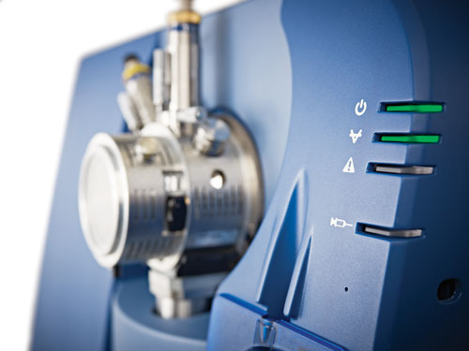
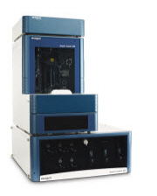
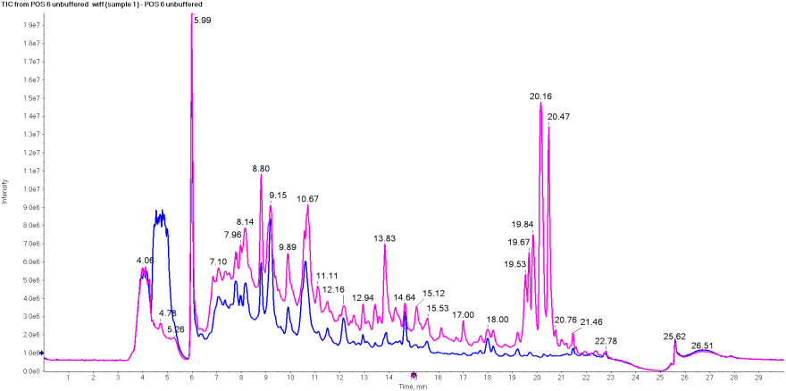
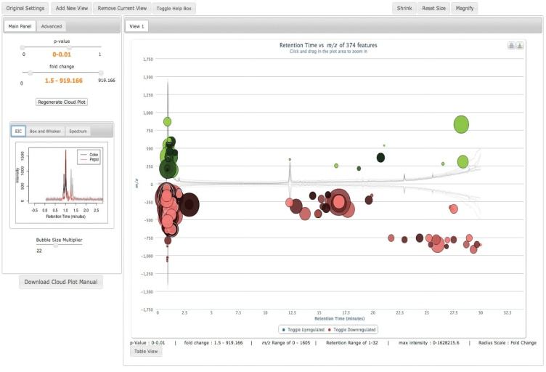
Untargeted Metabolomics: Tandem LC-MSMS

Slide 2
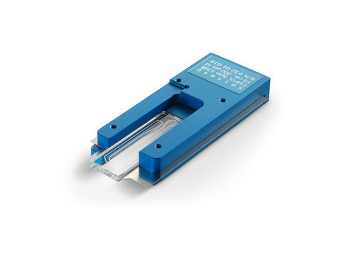
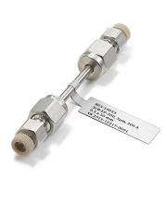
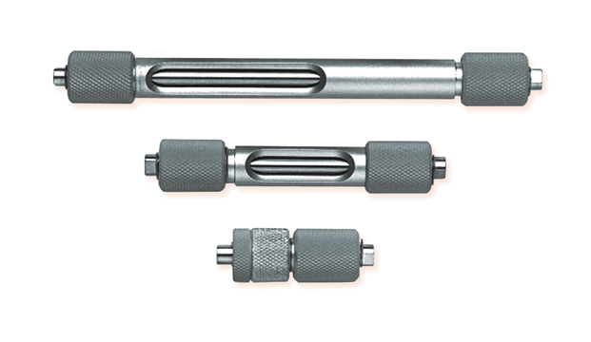
Column and Flow Rate Selection
Insert Barnes table for flow rates and sensitivity gain.
Reverse Phase and Normal Phase Selections:
Reverse Phase (C4, C8, C18, etc…)
Normal Phase (Silica, Amide, Amido, etc…)

Slide 3
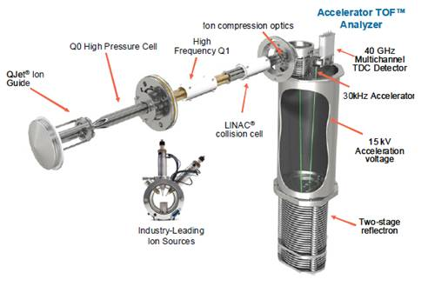
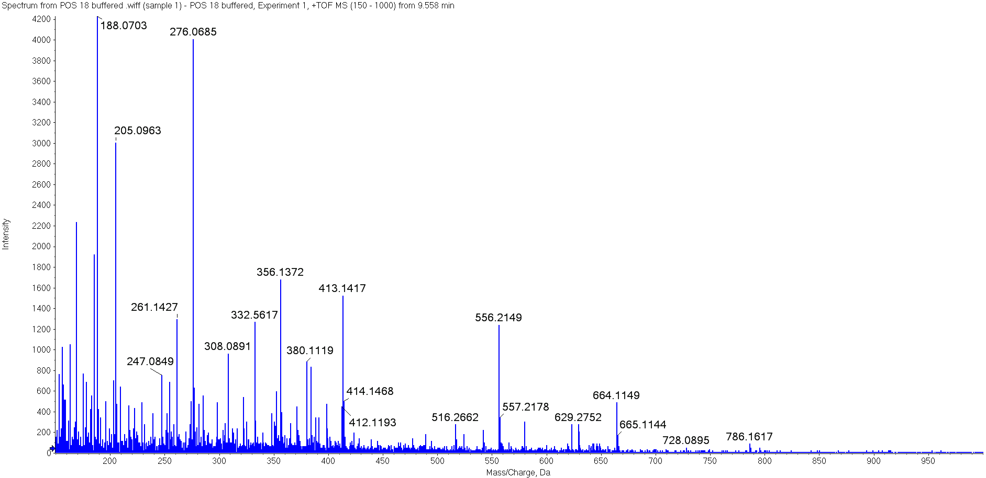
Instrument Configuration
AB Sciex 5600 Triple Tof Mass Spectrometer (Q-Tof MS )
The Time of Flight (ToF) chamber allows for rapid detection and high mass accuracy as compared to traditional triple quadrupole instrumentation. All fragments are detected simultaneously instead of a precursor (parent ion) > fragment (daughter ion) pair.

Slide 4
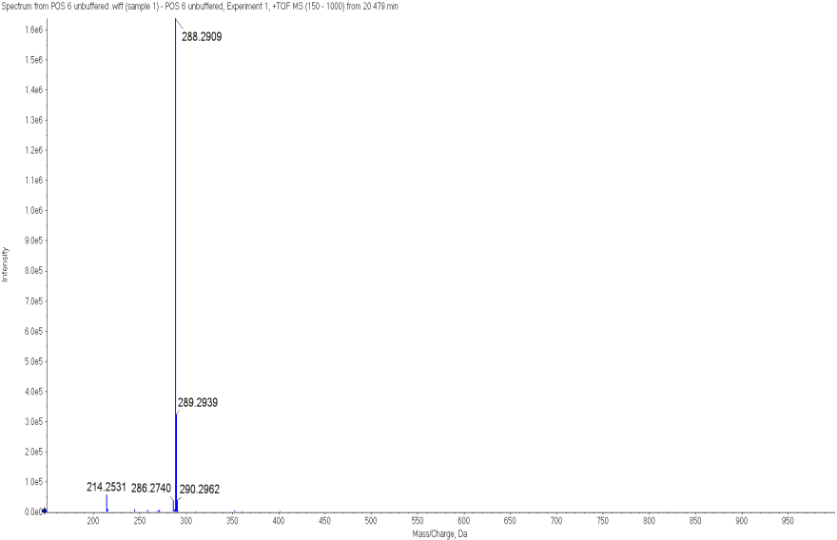
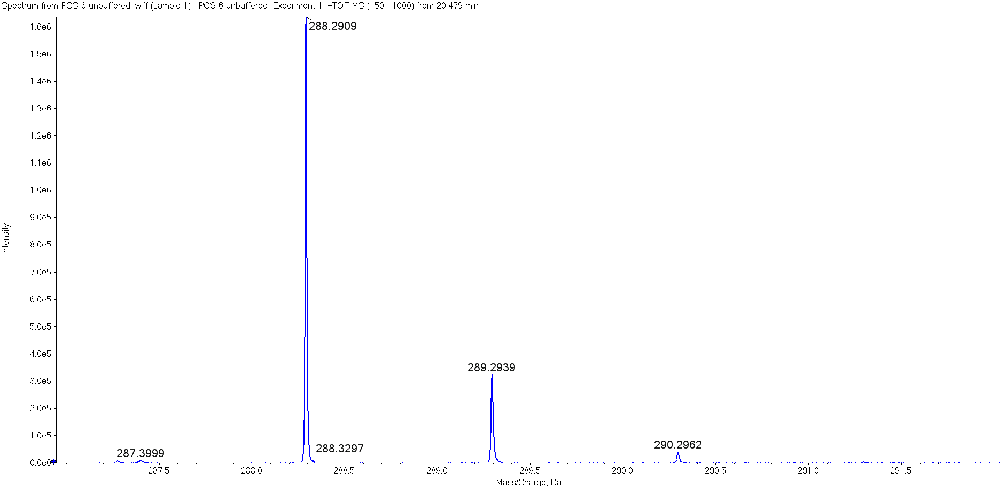
High Resolution and Acquisition Speed
Precursor Scans collected over 100 msec;
Fragmentation Spectra collected as low as 10 msec.

Slide 5
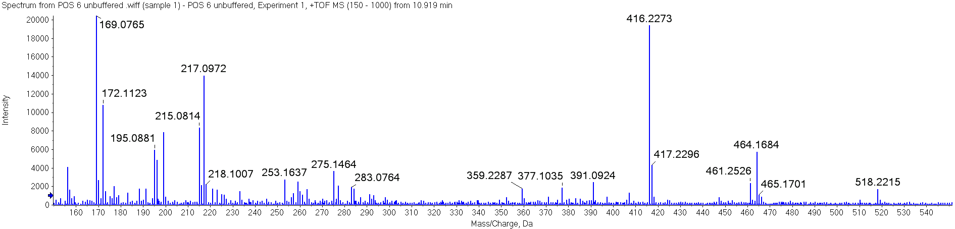
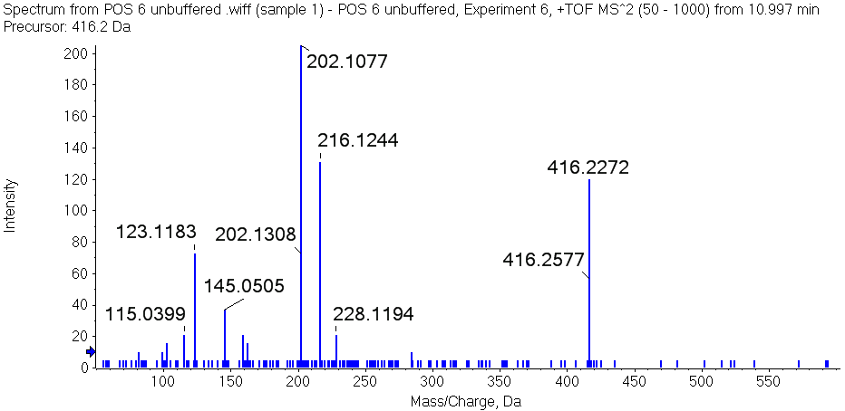
Typical Instrument Acquisition Method
Precursor Ion Scan: 250 msec
Product Ion Scan: 50 msec (X 20)
Total Cycle Time is 1.25 seconds
Selected ion for fragmentation
The combination of precursor plus fragmentation scans in one method allows the investigator to simultaneously qualify and quantify potential compounds between experimental groups.
Example of MS/MS scan

Slide 6
Evaluation of Collected Data
Chromatographic reproducibility
Sample intensity comparisons
Mass accuracies between samples

Slide 7
Evaluation of Collected Data continued
Chromatography tracings overlap
Mass accuracy window set to 0.005 Daltons

Slide 8
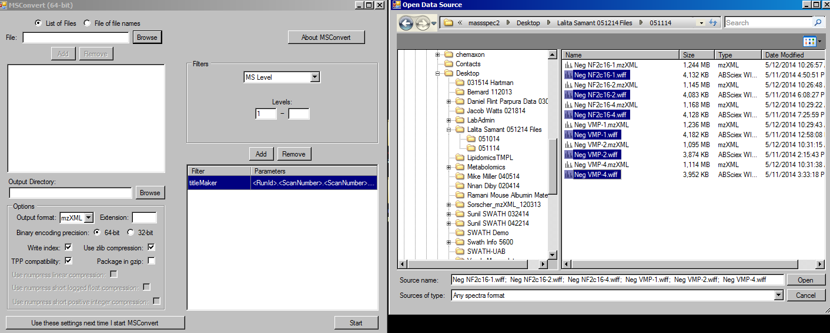
Exporting Data to Statistical Programs
Programs like MS Convert can transform instrument raw files (.wiff, .dta, etc) in usable formats such as mzXML. Keep in mind when transforming the raw data, the size of the files can increase significantly.

Slide 9

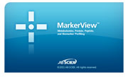
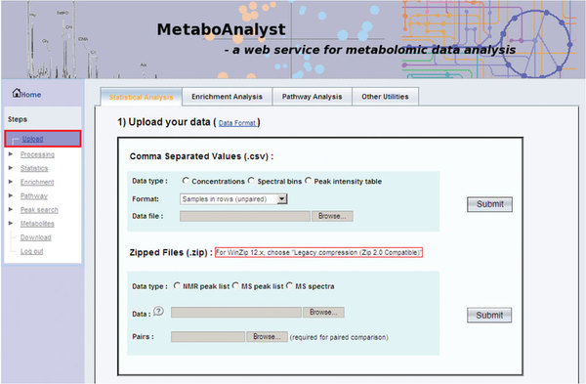
Data Analyses Software
There are a host of software platforms ranging from free online resources to company specific programs.

Slide 10
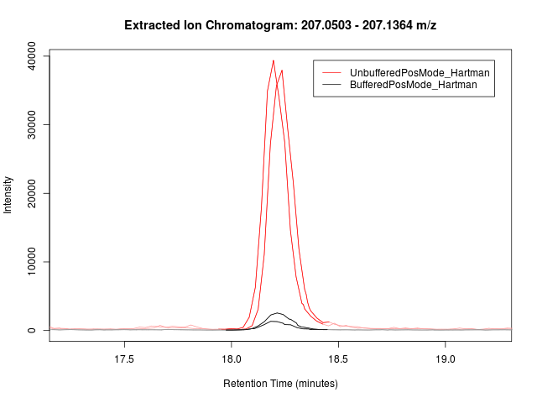
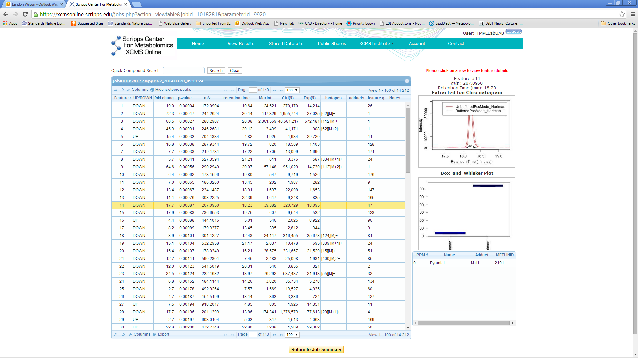
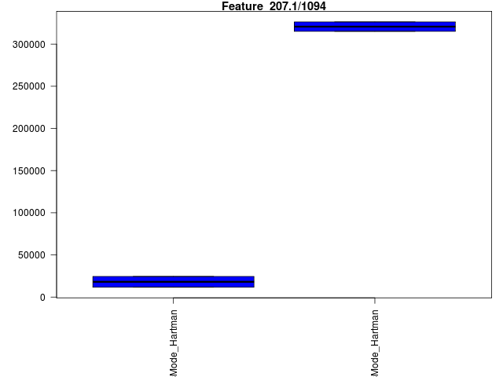
Data Analyses Software continued
XCMS Online aligns chromatography
and outputs user friendly schematics from uploaded data including PCA graphs, t-test, etc.

